Slide 1
Web Engineering
Course code: SE3003
Instructor: fahad hussain

Slide 2
Introduction to the Web
A web application refers to any type of an application that is being hosted or has been hosted on a web browser or either some part of the application has been hosted.
Working of the Web:
The client (web browser) requests the information.
The browser is responsible to make requests from the servers, then servers cater those requests and process them based on a certain set of protocols.
A web server software is responsible to process the request on the server and returns the information to the client.

Slide 3
Web Site Structure
A website consists of a number of different files.
A website contains:
HTML files
Contains Client Side Scripting (JS).
Image files
Most supported being among them (GIF and PNG)
Object Files
Helper files, plugins
Sound, video files
Server side scripts
Used to access server resources, ex: Database.

Slide 4
Static vs Dynamic Websites
Majority of websites that you view are of non-static in nature.
A static web page is a one where there is no involvement of server side resources and the server only responds to the query of the client without any internal manipulation of the query itself.
Dynamic websites in actuality are the responses from programs that are running on web servers.
These programs can interact with server side resources ex: Databases and XML web service.

Slide 5
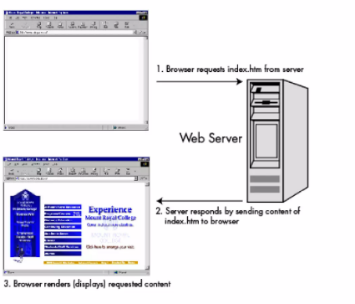
Static Web Content

Slide 6
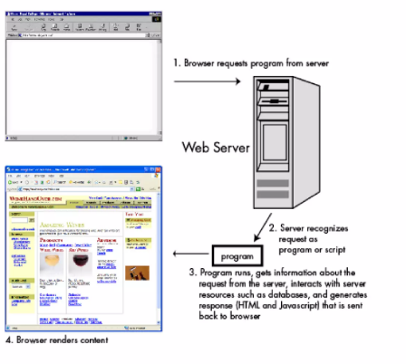
Dynamic Web Content

Slide 7
Dynamic Web Technologies
There are a number of different technologies used independently as well as collectively to create a dynamic web application.
ASP.NET
JSP
PHP
Ruby on Rails

Slide 8
Web View
Browser engine included in the application. WebView allows programmers to create most applications using her standard tools for web programming: HTML, JavaScript, and CSS. WebView also allows you to display her web content from external sites from within your application. The user does not have to switch to her web browser or any other user interface.
Can be found on multiple platforms such as Android as well as ASP.NET.

Slide 9
HTML History and Introduction
1991- Tim Berners-Lee invents HTML 1.0
1993- HTML 1.0 is released. Not many developers are creating websites at this time.
1995- HTML 2.0 is published. This contains the features of HTML 1.0 plus new features. This remained the standard markup language for designing and creating websites until 1997.
1997- HTML 3.0 was invented. Here, Dave Raggett introduced a fresh draft on HTML, which improved new features of HTML and gave more powerful characteristics for webmasters in designing websites. Unfortunately, the powerful features slowed down the browser in applying further improvements.
1999- The widely-used HTML 4.0 comes out. It is very successful.
2014- HTML 5.0 is released and used worldwide. It is said to be the extended version of HTML 4.01 which was published in 2012.

Slide 10
Basic HTML Tags
Heading.
Paragraph
Div
Span
Strong
Emphasied
Small
Mark
Delete (strike thorugh)
Bold
Italic
Underline
Pre
Ordered list
Unordered list

Slide 11
Basic HTML Tags
Quotation and Citation:
Abbreviations
Citation
Short quote
Address for Contact
Block Quote
Comment (!-- anything -->)
HTML Colors (Almost 140 colors supported by HTML):
Background Color
Text Color
Border Color

Slide 12
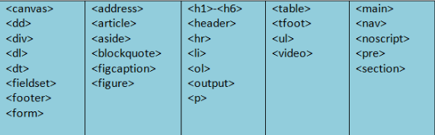
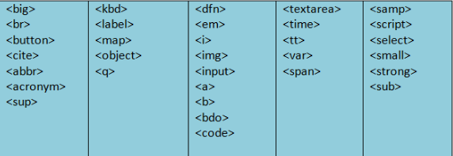
Block vs Inline Elements
Depending on the type of element it is, every HTML element has a default display value. Block and inline are the two display settings available.
A block-level element always begins on a new line, and browsers add a margin (a space) before and after the element by default. A block-level element always occupies the entire available width (stretches out to the left and right as far as it can).
A line break is not used to begin an inline element.
An inline element only uses the space that is required.

Slide 13
Advanced HTML tags
Image.
Hyperlink
Subscript
Superscript
Favicon
HTML Tables:
Border
Sizes
Header
Colspan and Rowspan
Iframes

